Slide 1
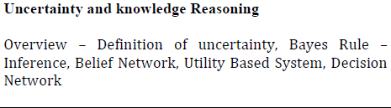
UNCERTAINTY
&
KNOWLEDGE REASONING

Slide 2
Outline
Introduction
Uncertainty
Probability
Syntax and Semantics
Inference
Independence and Bayes' Rule

Slide 3
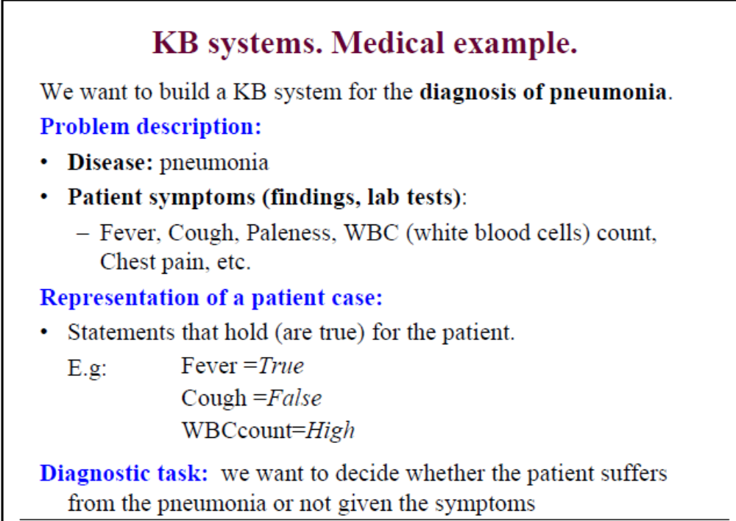


Slide 4
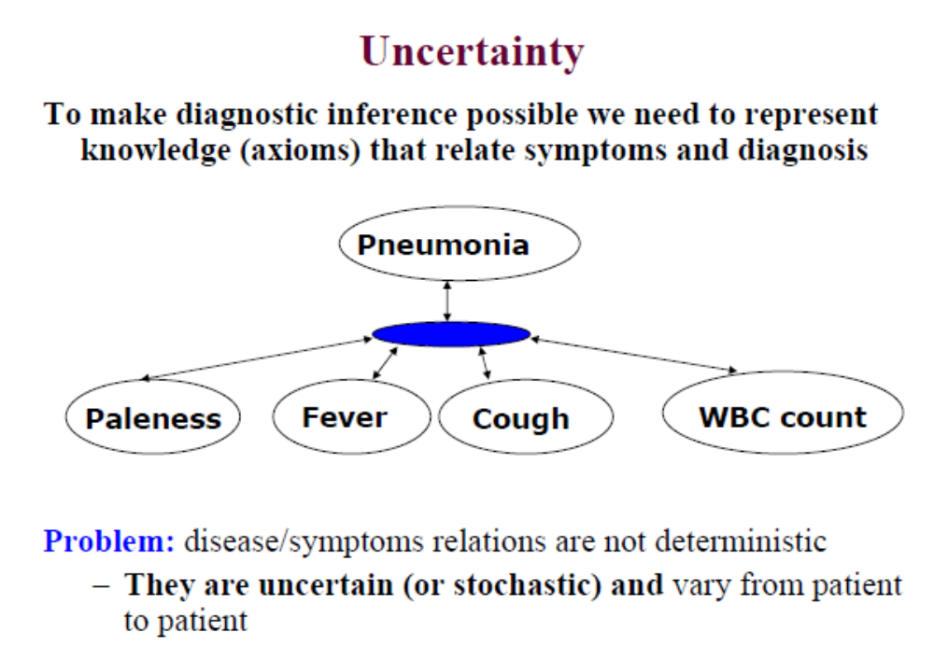

Slide 5
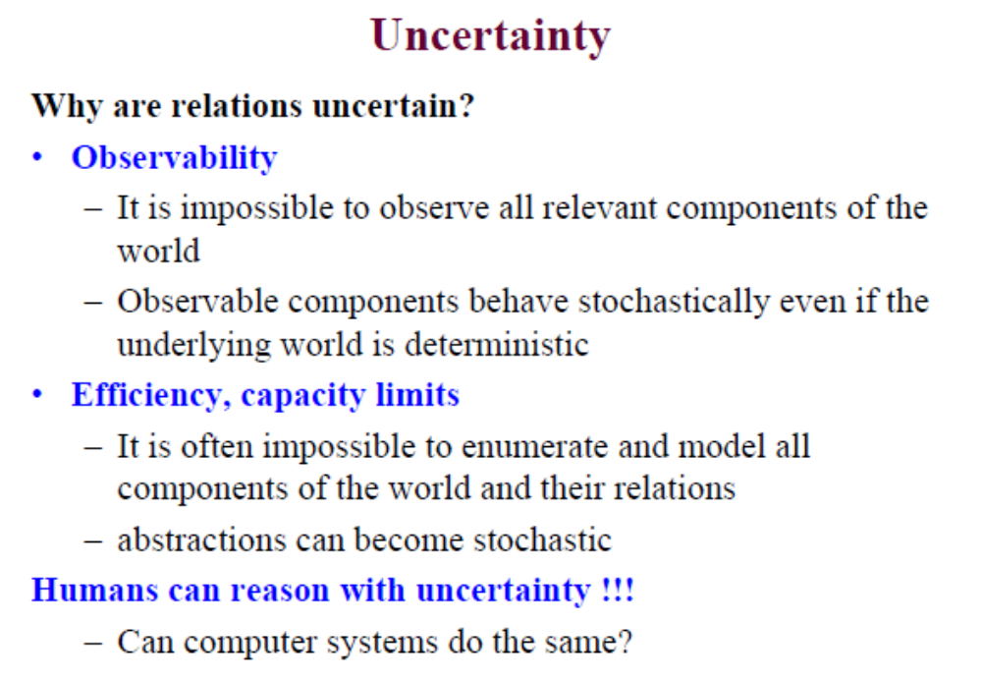

Slide 6
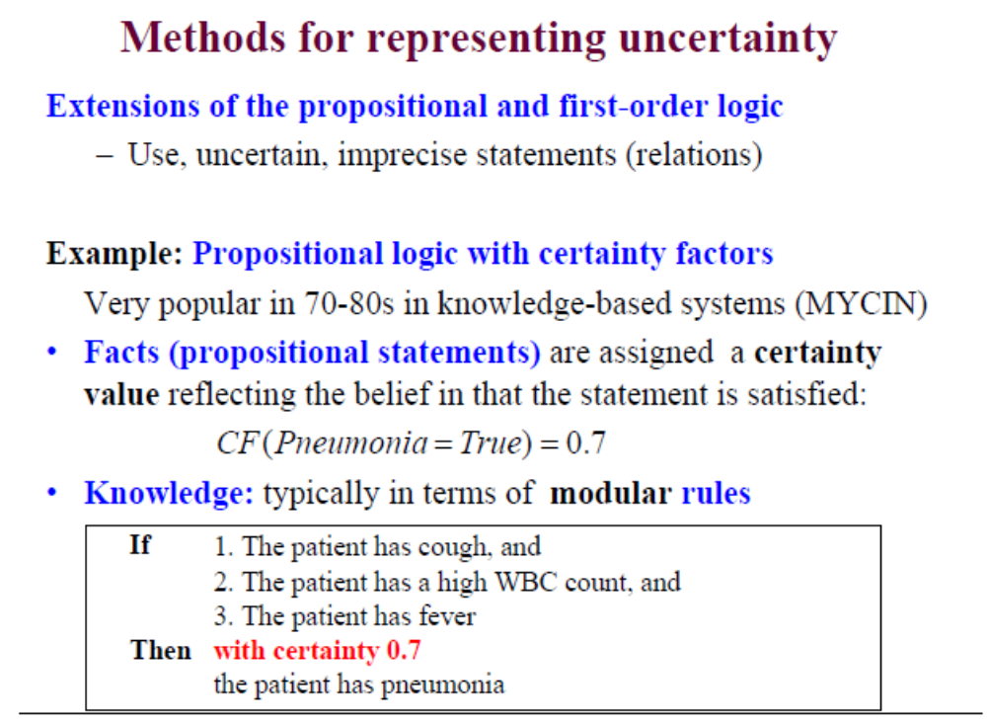
CF-Cystic fibrosis

Slide 7
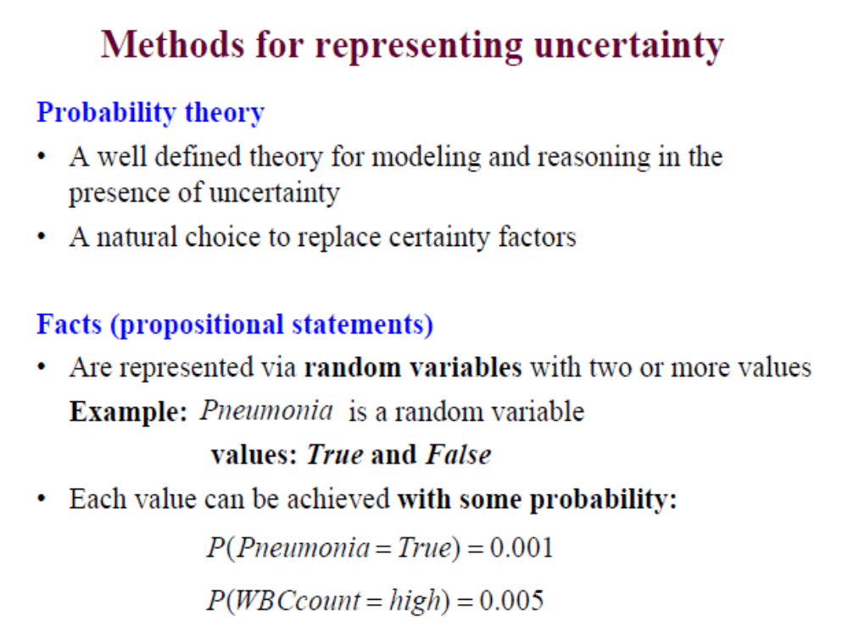

Slide 8
Uncertainty
Let action A_{t} = leave for airport _{t} minutes before flight
Will A_{t} get me there on time?
Problems:
  partial observability (road state, other drivers' plans, etc.)
  noisy sensors (traffic reports)
  uncertainty in action outcomes (flat tire, etc.)
  immense complexity of modeling and predicting traffic
Hence a purely logical approach either
  risks falsehood: “A₂₅ will get me there on time”, or
  leads to conclusions that are too weak for decision making:
“A₂₅ will get me there on time if there's no accident on the bridge and it doesn't rain and my tires remain intact etc etc.”
(A₁₄₄₀ might reasonably be said to get me there on time but I'd have to stay overnight in the airport …)

Slide 9
Handling Uncertain Knowledge
Problems using first-order logic for diagnosis:
Laziness:
Too much work to make complete rules.
Too much work to use them
Theoretical ignorance:
Complete theories are rare
Practical ignorance:
We can’t run all tests anyway
Probability can be used to summarize the laziness
and ignorance !

Slide 10
Using FOL for (Medical) Diagnosis
∀ p Symptom(p, Toothache) ⇒ Disease(p, Cavity)
Not correct...
∀ p Symptom(p, Toothache) ⇒ Disease(p, Cavity)
∨ Disease(p, GumDisease) ∨ Disease(p, WisdomTooth) ∨ Disease(p, Abscess)
Not complete...
∀ p Disease(p, Cavity) ⇒ Symptom(p, Toothache)
Not correct...

Slide 11
Methods for handling uncertainty
Default or nonmonotonic logic:
  Assume my car does not have a flat tire
  Assume A₂₅ works unless contradicted by evidence
Issues: What assumptions are reasonable? How to handle contradiction?
Rules with fudge factors:
  A₂₅ |→_{0.3} get there on time
  Sprinkler |→ _{0.99} WetGrass
  WetGrass |→ _{0.7} Rain
Issues: Problems with combination, e.g., Sprinkler causes Rain??
Probability
  Model agent's degree of belief
  Given the available evidence,
  A₂₅ will get me there on time with probability 0.04

Slide 12
Rational Decisions
A rational decision must consider:
  The relative importance of the sub-goals
  Utility theory
  The degree of belief that the sub-goals will be achieved
  Probability theory
Decision theory = probability theory + utility theory :
the agent is rational if and only if it chooses the action
that yields the highest expected utility, averaged over
all possible outcomes of the action”

Slide 13
Combining Beliefs & Desires under Uncertainty
Modern agents talks of utility rather than good and evil, but the principle is exactly the same.
Agent’s preferences between world states are captured by a Utility Function U(S)
It assign a single number to express the desirability of a state.
Utilities are combined with outcome probabilities of actions to give an expected utility for each action
A nondeterministic action A will have possible outcome states Result_{i}(A) where the index i ranges over the different outcomes.
Prior to the execution of A, the agent assigns probability P (Result_{i} (A) | Do (A), E) to each outcome, where E summarizes the agent’s available evidence about the world and Do (A) is the proposition that action A is executed in the current state.
The expected utility of A is
EU[A] = S_{i=1,…,n} p(Result_{i}(A) | Do (A)U(Result_{i})
The principle of maximum expected utility (MEU) says that a rational agent should choose an action

Slide 14
Non-Deterministic vs.
Probabilistic Uncertainty
?
?
a
b
c
a
b
c
{a,b,c}
decision that is
best for worst case
{a(pa),b(pb),c(pc)}
decision that maximizes
expected utility value
Non-deterministic model
Probabilistic model
~ Adversarial search

Slide 15
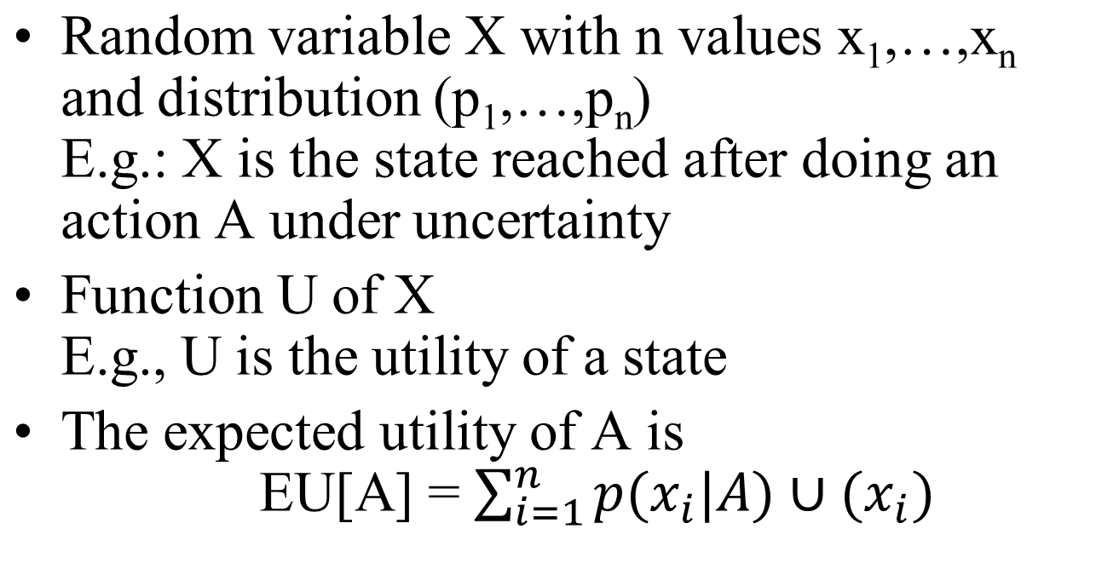
Expected Utility

Slide 16
One State/One Action Example
s0
U(S0) = 100 x 0.2 + 50 x 0.7 + 70 x 0.1
= 20 + 35 + 7
= 62
A1
s1
s2
s3
0.2
0.7
0.1
100
50
70

Slide 17
One State/Two Actions Example
s0
U1(S0) = 62
U2(S0) = 74
U(S0) = max{U1(S0),U2(S0)}
= 74
A1
A2
s1
s2
s3
s4
0.2
0.7
0.2
0.1
0.8
100
50
70
80

Slide 18
Introducing Action Costs
s0
U1(S0) = 62 – 5 = 57
U2(S0) = 74 – 25 = 49
U(S0) = max{U1(S0),U2(S0)}
= 57
A1
A2
-5
-25
s1
s2
s3
s4
0.2
0.7
0.2
0.1
0.8
100
50
70
80

Slide 19
Maximum Expected Utility (MEU) Principle
A rational agent should choose the action that maximizes agent’s expected utility
This is the basis of the field of decision theory
The MEU principle provides a normative criterion for rational choice of action

Slide 20
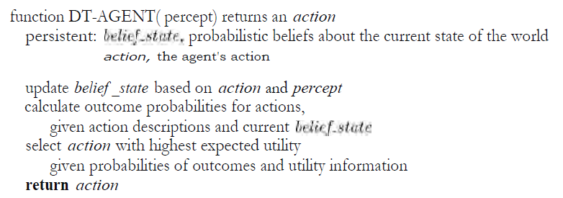
Design for decision-theoretic agent

Slide 21
Probability
A measure of how likely it is that some event will occur; a number expressing the ratio of favorable cases to the whole number of cases possible
Probabilistic assertions summarize effects of
  laziness: failure to enumerate exceptions, qualifications, etc.
  ignorance: lack of relevant facts, initial conditions, etc.
Subjective probability:
Probabilities relate propositions to agent's own state of knowledge
e.g., P(A₂₅ | no reported accidents) = 0.06
These are not assertions about the world
Probabilities of propositions change with new evidence:
e.g., P(A₂₅ | no reported accidents, 5 a.m.) = 0.15

Slide 22
Probability
Probabilities are either:
Prior probability (unconditional , “obetingad”)
Before any evidence is obtained
Posterior probability (conditional , “betingad”)
After evidence is obtained
The axioms of probability constrain the possible
assignments of probabilities to propositions. An agent
that violates the axioms will behave irrationally in
some circumstances

Slide 23
Making decisions under uncertainty
Suppose I believe the following:
  P(A₂₅ gets me there on time | …) = 0.04
  P(A₉₀ gets me there on time | …) = 0.70
  P(A₁₂₀ gets me there on time | …) = 0.95
  P(A₁₄₄₀ gets me there on time | …) = 0.9999
Which action to choose?
Depends on my preferences for missing flight vs. time spent waiting, etc.
  Utility theory is used to represent and infer preferences
  Decision theory = probability theory + utility theory

Slide 24
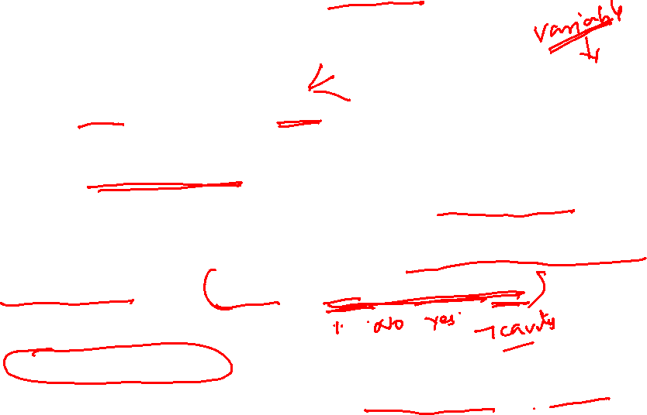
Syntax
Basic element: random variable
Similar to propositional logic: possible worlds defined by assignment of values to random variables.
Boolean random variables
  e.g., Cavity (do I have a cavity?)
Discrete random variables
  e.g., Weather is one of <sunny,rainy,cloudy,snow>
Domain values must be exhaustive and mutually exclusive
Elementary proposition constructed by assignment of a value to a
random variable: e.g., Weather = sunny, Cavity = false (abbreviated as ¬cavity)
Complex propositions formed from elementary propositions and standard logical connectives e.g., Weather = sunny ∨ Cavity = false

Slide 25
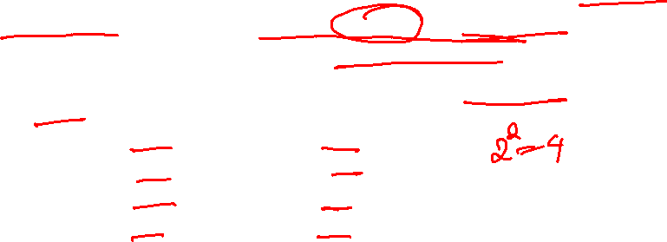
Syntax
Atomic event: A complete specification of the state of the world about which the agent is uncertain
  E.g., if the world consists of only two Boolean variables Cavity and Toothache, then there are 4 distinct atomic events:
    Cavity = false ∧Toothache = false
    Cavity = false ∧ Toothache = true
    Cavity = true ∧ Toothache = false
    Cavity = true ∧ Toothache = true
Atomic events are mutually exclusive and exhaustive

Slide 26
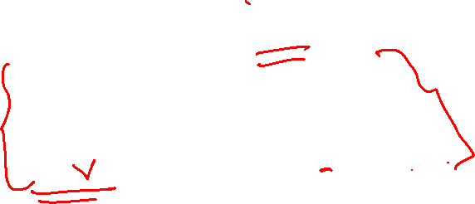
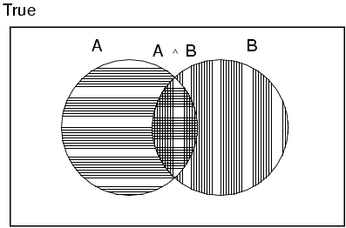
Axioms of probability
For any propositions A, B
  0 ≤ P(A) ≤ 1
  P(true) = 1 and P(false) = 0
  P(A ∨ B) = P(A) + P(B) - P(A ∧ B)
  These three axioms are often called Kolmogorov’s axioms.

Slide 27
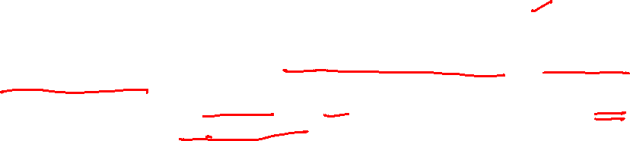

Prior probability
Prior or unconditional probabilities of propositions
Unconditional probability reflects the chance that some event will occur without accounting for any other possible influences or prior outcomes.
For instance, the chance of a fair coin flip being heads has an unconditional probability of 50% regardless of how many coin flips preceded it, nor if some other event had occurred.
Unconditional probability is also known as marginal probability.
Understanding Unconditional Probability
The unconditional probability of an event can be determined by adding up the outcomes of the event and dividing by the total number of possible outcomes.
Outcomes}}P(A) = Total Number of Possible OutcomesNumber of Times ‘A’ Occurs​﻿
Unconditional probability is also known as marginal probability and measures the chance of an occurrence ignoring any knowledge gained from previous or external events. Since this probability ignores new information, it remains constant.
  e.g., P(Cavity = true) = 0.1 and P(Weather = sunny) = 0.72 correspond to belief prior to arrival of any (new) evidence

Slide 28
Example of Unconditional Probability
As a hypothetical example from finance, let's examine a group of stocks and their returns.
A stock can either be a winner, which earns a positive return, or a loser, which has a negative returns.
Say that out of five stocks, stocks A and B are winners, while stocks C, D, and E are losers.
What, then, is the unconditional probability of choosing a winning stock?
Since two outcomes out of a possible five will produce a winner, the unconditional probability is 2 successes divided by 5 total outcomes (2 / 5 = 0.4), or 40%.

Slide 29

A probability distribution is a statistical function that describes all the possible values and likelihoods that a random variable can take within a given range. This range will be bounded between the minimum and maximum possible values, but precisely where the possible value is likely to be plotted on the probability distribution depends on a number of factors. These factors include the distribution's mean (average), standard deviation, skewness, and kurtosis.
Probability distribution gives values for all possible assignments:
  P(Weather) = <0.72,0.1,0.08,0.1> (normalized, i.e., sums to 1)
Joint probability distribution for a set of random variables gives the probability of every atomic event on those random variables
Weather = sunny rainy cloudy snow
Cavity = true 0.144 0.02 0.016 0.02
Cavity = false 0.576 0.08 0.064 0.08
Every question about a domain can be answered by the joint distribution
P(Weather,Cavity) = a 4 × 2 matrix of values:

Slide 30

Conditional probability
Conditional probability is defined as the likelihood of an event or outcome occurring, based on the occurrence of a previous event or outcome.
Conditional probability is calculated by multiplying the probability of the preceding event by the updated probability of the succeeding, or conditional, event.
Conditional probability is often portrayed as the "probability of A given B," notated as P(A|B).
Unconditional probability also differs from joint probability, which calculates the likelihood of two or more outcomes occurring simultaneously, and portrayed as the "probability of A and B", written as P(A ∩ B).
It essentially incorporates the unconditional probabilities of A and B.
Conditional or posterior probabilities
  e.g., P(cavity | toothache) = 0.8
  i.e., given that toothache is all I know
(Notation for conditional distributions:
  -P(Cavity | Toothache) = 2-element vector of 2-element vectors)
  -If we know more, e.g., cavity is also given, then we have
  P(cavity | toothache,catch) = 1
New evidence may be irrelevant, allowing simplification, e.g.,
  P(cavity | toothache, sunny) = P(cavity | toothache) = 0.8
This kind of inference, sanctioned by domain knowledge, is crucial

Slide 31

For EXAMPLE:
Event A is that an individual applying for college will be accepted. There is an 80% chance that this individual will be accepted to college.
Event B is that this individual will be given dormitory housing. Dormitory housing will only be provided for 60% of all of the accepted students.
P (Accepted and dormitory housing) = P (Dormitory Housing | Accepted) P (Accepted) = (0.60)*(0.80) = 0.48.
A conditional probability would look at these two events in relationship with one another, such as the probability that you are both accepted to college, and you are provided with dormitory housing.
Conditional probability can be contrasted with unconditional probability. Unconditional probability refers to the likelihood that an event will take place irrespective of whether any other events have taken place or any other conditions are present.

Slide 32
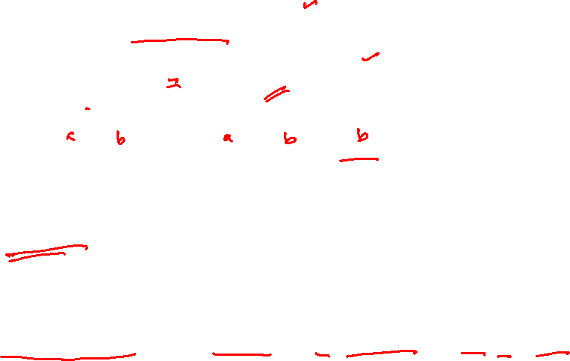
Conditional probability
Definition of conditional probability:
  P(a | b) = P(a ∧ b) / P(b), if P(b) > 0
Product rule gives an alternative formulation:
  P(a ∧ b) = P(a | b) P(b) = P(b | a) P(a)
A general version holds for whole distributions,
e.g.,P(Weather,Cavity) = P(Weather | Cavity) P(Cavity)
(View as a set of 4 × 2 equations, not matrix mult.)
Chain rule is derived by successive application of product rule:
  P(X₁, …,X_{n}) = P(X₁,...,X_{n-1}) P(X_{n} | X₁,...,X_{n-1})
  = P(X₁,...,X_{n-2}) P(X_{n-1} | X₁,...,X_{n-2}) P(X_{n} | X₁,...,X_{n-1})
  = …
  = π_{i= 1}^n P(X_{i} | X₁, … ,X_{i-1})
  Or
  P(A1, A2, ..., An) = P(A1| A2, ..., An) P(A2| A3, ..., An) P(An-1|An) P(An)

Slide 33

Inference by Enumeration
Joint probability: p(A and B). The probability of event A and event B occurring. It is the probability of the intersection of two or more events. The probability of the intersection of A and B may be written p(A ∩ B). Example: the probability that a card is a four and red =p(four and red) = 2/52=1/26. (There are two red fours in a deck of 52, the 4 of hearts and the 4 of diamonds).
Inference by enumeration is the general framework for solving inference queries when a joint distribution is given.
Start with the joint probability distribution:
For any proposition φ, sum the atomic events where it is true: P(φ) = Σ_{ω:ω╞φ} P(ω)

Slide 34


Inference by enumeration
Start with the joint probability distribution:
For any proposition φ, sum the atomic events where it is true: P(φ) = Σ_{ω:ω╞φ} P(ω)
P(toothache) = 0.108 + 0.012 + 0.016 + 0.064 = 0.2

Slide 35

Inference by enumeration
Start with the joint probability distribution:
Can also compute conditional probabilities:
P(¬cavity | toothache) = P(¬cavity ∧ toothache)
P(toothache)
= 0.016+0.064
0.108 + 0.012 + 0.016 + 0.064
= 0.4

Slide 36
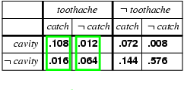
Normalization
Denominator can be viewed as a normalization constant α
P(Cavity | toothache) = α, P(Cavity,toothache)
  = α, [P(Cavity,toothache,catch) + P(Cavity,toothache,¬ catch)]
  = α, [<0.108,0.016> + <0.012,0.064>]
  = α, <0.12,0.08> = <0.6,0.4>
General idea: compute distribution on query variable by fixing evidence variables and summing over hidden variables

Slide 37
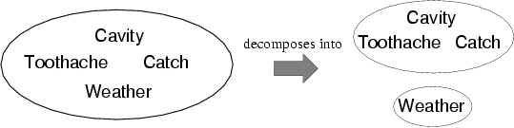
Independence
A and B are independent iff
P(A|B) = P(A) or P(B|A) = P(B) or P(A, B) = P(A) P(B)
  P(Toothache, Catch, Cavity, Weather)
  = P(Toothache, Catch, Cavity) P(Weather)
32 entries(4x2x2x2) reduced to 12; for n independent biased coins, O(2^{n}) →O(n)
Absolute independence powerful but rare
Dentistry is a large field with hundreds of variables, none of which are independent. What to do?
P(Weather,Cavity) = a 4 × 2 matrix of values:
Weather = sunny rainy cloudy snow
Cavity = true 0.144 0.02 0.016 0.02
Cavity = false 0.576 0.08 0.064 0.08

Slide 38
Conditional independence
P(Toothache, Cavity, Catch) has 2³ – 1 = 7 independent entries
If I have a cavity, the probability that the probe catches in it doesn't depend on whether I have a toothache:
  (1) P(catch | toothache, cavity) = P(catch | cavity)
The same independence holds if I haven't got a cavity:
  (2) P(catch | toothache,¬cavity) = P(catch | ¬cavity)
Catch is conditionally independent of Toothache given Cavity:
  P(Catch | Toothache,Cavity) = P(Catch | Cavity)
Equivalent statements:
  P(Toothache | Catch, Cavity) = P(Toothache | Cavity)
  P(Toothache, Catch | Cavity) = P(Toothache | Cavity) P(Catch | Cavity)

Slide 39
Conditional independence contd.
Write out full joint distribution using chain rule:
P(Toothache, Catch, Cavity)
  = P(Toothache | Catch, Cavity) P(Catch, Cavity)
  = P(Toothache | Catch, Cavity) P(Catch | Cavity) P(Cavity)
  = P(Toothache | Cavity) P(Catch | Cavity) P(Cavity)
I.e., 2 + 2 + 1 = 5 independent numbers
In most cases, the use of conditional independence reduces the size of the representation of the joint distribution from exponential in n to linear in n.
Conditional independence is our most basic and robust form of knowledge about uncertain environments.

Slide 40
Bayes' Rule
Product rule P(a∧b) = P(a | b) P(b) = P(b | a) P(a)
⇒ Bayes' rule: P(a | b) = P(b | a) P(a) / P(b)
or in distribution form
P(Y|X) = P(X|Y) P(Y) / P(X) = αP(X|Y) P(Y)
Useful for assessing diagnostic probability from causal probability:
  P(Cause|Effect) = P(Effect|Cause) P(Cause) / P(Effect)
  E.g., let M be meningitis, S be stiff neck:
    P(m|s) = P(s|m) P(m) / P(s) = 0.8 × 0.0001 / 0.1 = 0.0008
  Note: posterior probability of meningitis still very small!

Slide 41
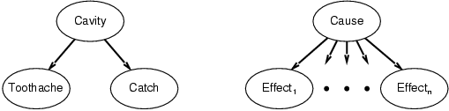
Bayes' Rule and conditional independence
P(Cavity | toothache ∧ catch)
  = αP(toothache ∧ catch | Cavity) P(Cavity)
  = αP(toothache | Cavity) P(catch | Cavity) P(Cavity)
This is an example of a naïve Bayes model:
  P(Cause,Effect₁, … ,Effect_{n}) = P(Cause) π_{i}P(Effect_{i}|Cause)
Total number of parameters is linear in n

Slide 42
Summary
Probability is a rigorous formalism for uncertain knowledge
Joint probability distribution specifies probability of every atomic event
Queries can be answered by summing over atomic events
For nontrivial domains, we must find a way to reduce the joint size
Independence and conditional independence provide the tools

